Slide 1
Entity Object
(Section 2)

Slide 2
Lifecycle of an entity object
When a client starts or commits a new business transaction , it go through certain stages in the lifecycle.
Create a new entity row : When you create an instance of an entity object by using the createInstance2(DBTransaction,AttributeList) method on the entity definition, its state is New.
Find and update an entity row : When a client invokes finder methods on an entity definition or on an entity based view object the state of these entity rows will be marked as Unmodified. When the client modifies some attributes, the state is transitioned to Modified.
Remove an entity row : When a client calls the remove method on an entity object, entity state becomes Deleted and it will be added to the transaction cycle.
Commit the transaction : On successful commit to the database, all the entities in the state New and Modified will be transitioned to Unmodified, and Deleted entity rows will be transitioned to the Dead state.

Slide 3
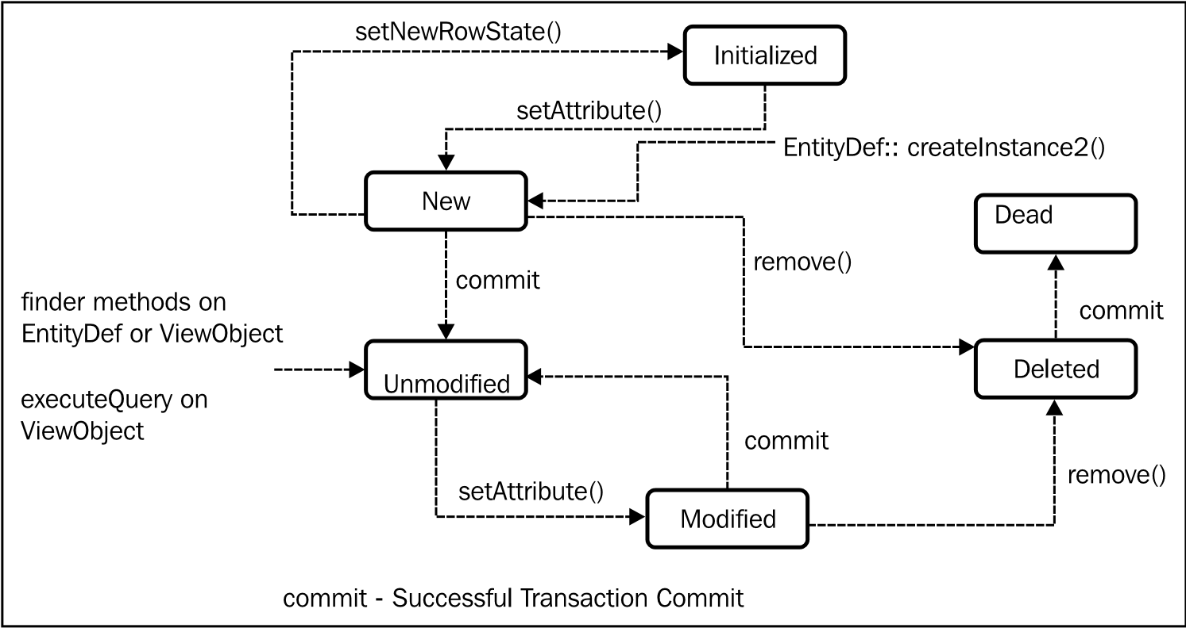
Lifecycle of an entity object

Slide 4
Reading the current state of an entity row
You can use the getEntityState() and the getPostState() methods on an entity object to access the current state of an entity row.
The getEntityState() method gives you the current state of an entity row with regard to the transaction.
The getPostState() method gives you the current state of an entity row with regard to the database.
Statuses :
Entity.STATUS_NEW
Entity.STATUS_MODIFIED
Entity.STATUS_UNMODIFIED
Entity.STATUS_DEAD

Slide 5
Reading the originally retrieved attribute value
There are use cases where you may want to read the originally retrieved values of the entity attributes in your business logic.
If you need to read the originally retrieved value for an attribute in an entity, you can use either of the following:
Call getAttribute(attrIndex,EntityImpl.ORIGINAL_VERSION) on an entity object.
Call getPostedAttribute(int attribIndex) on an entity object. This is a protected method in the EntityImpl class, and cannot be accessed by a client unless you expose it through an overridden public method through a subclass.

Slide 6
Retrieving all entity instances in the cache
You can retrieve all entity instances in the cache for a specific definition, including the deleted entity rows, using the method getAllEntityInstancesIterator() on the entity definition instance.
Iterator iterator =
EntityDefImpl.findDefObject("model.entity.DepartmentEO").
getAllEntityInstancesIterator(getDBTransaction());

Slide 7
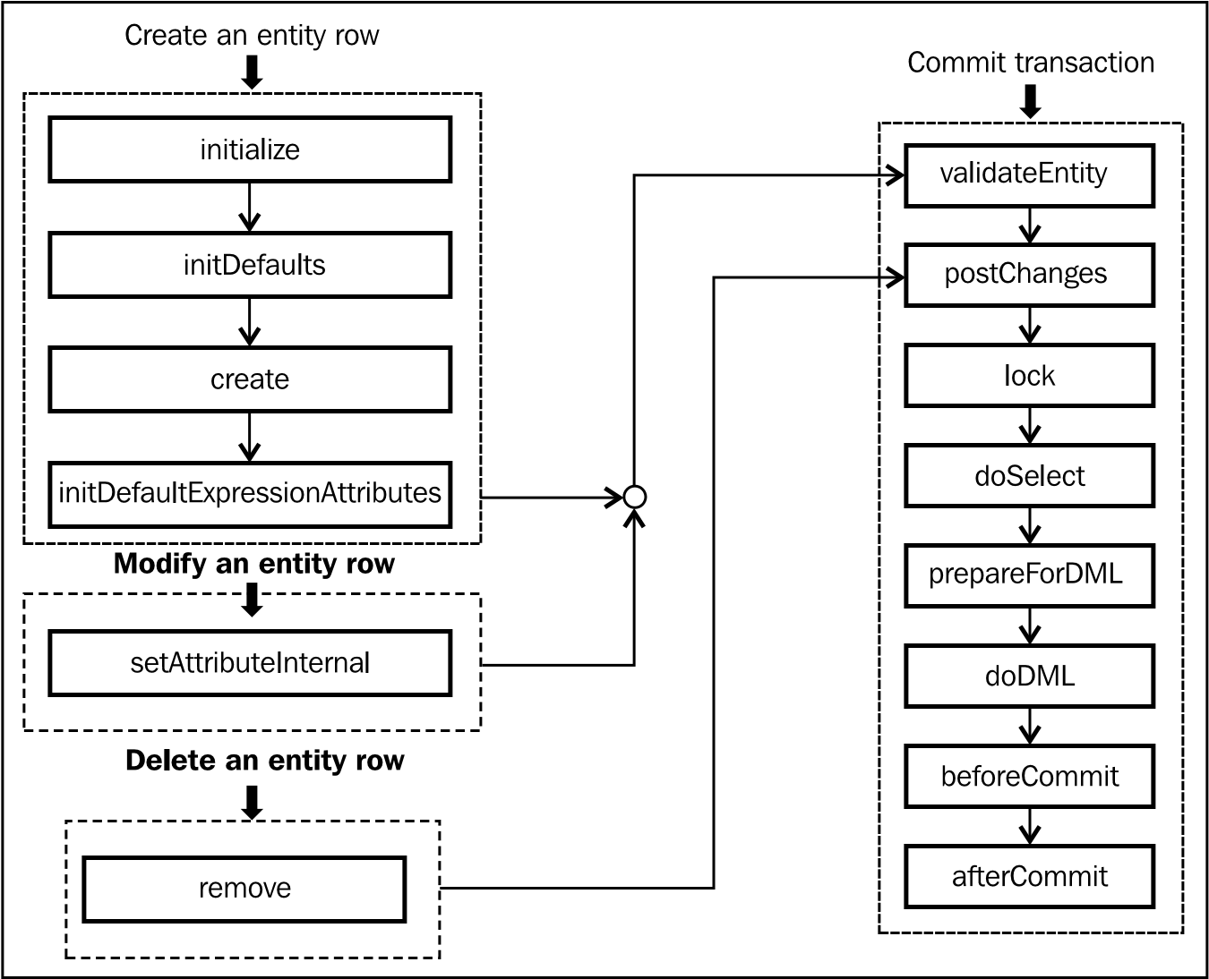
Lifecycle callback methods of an entity object

Slide 8
callback methods : When a new entity instance is created?
initialize(): When you create a new entity instance, under the cover, the framework performs the basic initialization tasks for the new instance. After running the mandatory initialization activities, the framework invokes initialize() on the entity instance.
initDefaults(): This method initializes default values for a newly created entity row using the default static value settings from the entity definition.
create(AttributeList nameValuePair): This method takes an attribute list for initializing the newly created row. The framework uses this method to pass foreign key values to the newly created child entity row if it is part of composition association.
initDefaultExpressionAttributes(AttributeList nameValuePair): This method initializes an entity row with values evaluated from expressions that are defined on the attributes.

Slide 9
callback methods : When a new entity instance is created?
The right place to add your programmatic logic for initializing entity attributes is in the overridden initDefaultExpressionAttributes(AttributeList nameValuePair).
This has the following advantages:
Your initialization logic can safely refer the attributes initialized through both Groovy and static values.
When you revert a new row back to the Initialized state by calling refresh(int refMode) on it, the entity object's initDefaultExpressionAttributes() method is invoked, but not its create() method.

Slide 10
callback methods : When an entity instance is modified or removed?
setAttributeInternal(int index, Object val): This method is the global entry point for all attribute updates for an entity row. This method is called to set an attribute value after validating the value against declarative validators set for that attribute.
remove(): This method is invoked when a client calls remove() on an entity instance. The framework marks the row for deletion and adds it to the transaction listener list.

Slide 11
callback methods : When the transaction is committed?
validateEntity(): This method validates the current entity row as well as all the child entities linked through composition association. This method is triggered by the framework for row currency (current row) change and for committing the transaction.
postChanges(TransactionEvent e): This method controls the data post cycle for the current entity row as well as for all child entity rows linked through a composition association. Depending on the state of this entity object, this method calls the following operations : lock, preprareForDML, and doDML

Slide 12
callback methods : When the transaction is committed?
lock(): This method locks the row by calling doSelect(lock) with the lock flag set to true. If the row is new or already locked by this entity object, or if the transaction's locking mode is None, then this method does not do anything at runtime.
doSelect(boolean lock): This method performs SELECT or SELECT FOR UPDATE processing for the current row depending upon the lock flag value. This method is invoked by the framework in the following scenarios:
When the framework calls lock() on the current row, this method is invoked with the lock flag set as true.
When a client calls findByPrimaryKey on an entity definition to find a specific entity row.
When a client calls findByKey() on a view object.
When a client tries to read an attribute which is missing from the entity cache.
When a client tries to update an attribute which is missing from the entity cache.
When a client calls refresh() on a row to refresh with the database.

Slide 13
callback methods : When the transaction is committed?
prepareForDML(int operation, TransactionEvent e): As the name suggests, this method is invoked before posting changes to the database which allows subclasses to modify any attributes on this entity before posting changes to the database.
In the case of batch mode, the modified entities in a transaction are posted in two steps. In the first step, the transaction manager notifies all entities with prepareForDML() so that entities can make changes to any attributes
In the case of non-batch mode, the transaction manager invokes the postChanges() method on the entity. The postChanges() in turn invokes prepareForDML() followed by doDML().

Slide 14
callback methods : When the transaction is committed?
doDML(int operation, TransactionEvent e): This method performs insert, update, and delete processing for the row. This uses appropriate SQL builder implementation for building the java.sql.PreparedStatement.
beforeCommit(TransactionEvent e): This method is invoked on each entity row participating in the transaction after the changes have been posted to the database, but before committing the transaction to the database.

Slide 15
callback methods : When the transaction is committed?
If the overridden beforeCommit() logic throws a ValidationException when you commit the transaction, then it is recommended to set the jbo.txn. handleafterpostexc property to true in the application module configuration. This property tells the framework to automatically handle the rolling back of the other entity objects that may have already successfully posted to the database (but not yet committed).
afterCommit(TransactionEvent e): This method is invoked on each entity row in the transaction's pending changes list after the changes have been successfully committed to the database.

